Slide 1
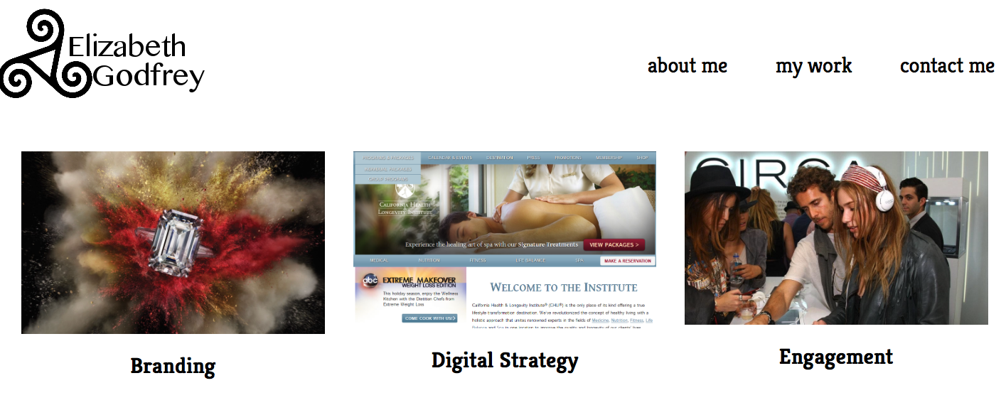

Slide 2
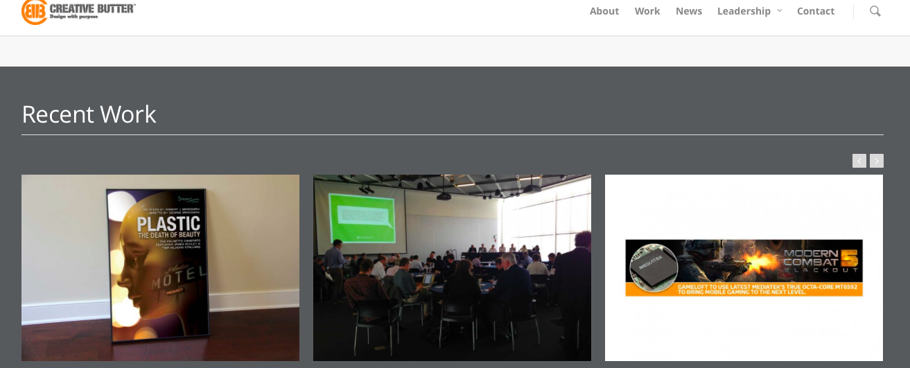
Unit 7 MidTerm
Defining your audience/tone
My audience is marketing professionals for luxury/fashion related brands. The tone is cool but a little sophisticated with interesting, high-end images
What existing websites out there were you most inspired by
Creative Butter www.creativebutter.com

Slide 3
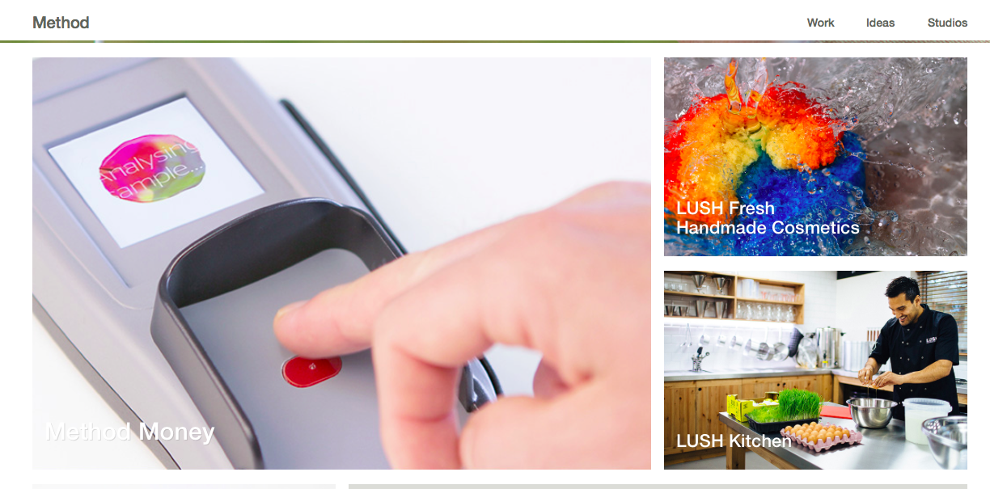
Unit 7 Midterm
Method www.method.com
Because they offer similar services to mine

Slide 4
Unit7 Midterm
Parts of your design you're most proud of
It’s still at a pretty rudimentary stage, but I like that it’s clean and simple with the images as the focal point
The struggles you encountered in your design process
Trying to figure out the best way to group and present the information in a way that is easy to navigate and provides the best possible user experience.
Parts of the development process that you overcame
Not sure

Slide 5
Unit7 Midterm
The struggles you encountered when developing the page
I’m still just trying to synthesize everything we’ve learned and figure out how to put it into practice
What you learned from working through this mid-term project
I’ve learned that I’m not as clear on some of the elements of building the page like the floats and clears. It’s good to actually have to use them, b/c you realize what you do understand and what you don’t

